Slide 1
Developing an Effective IRB Application
Eastern Mennonite University Institutional Review Board
emu.edu/irb

Slide 2
Historical Origins
The need for Institutional Review Boards (IRB) and for the proposal and review process arises from historical abuses in research some of which include:
Nuremberg trials: revealed inhumane medical experimentation by WWII doctors :Gives rise to the Nuremberg Code of 1945
Declaration of Helsinki: in 1964 addressed the spread of biomedical research
Tuskegee Syphilis Study, 1972: Disclosure of 30-year government-supported syphilis research (300 black men diagnosed with syphilis went untreated, told they had “bad blood”)
Prompted public Law 93-348 calling for the National Commission for Protection of Human Subjects of Biomedical and Behavioral Research

Slide 3
Three Primary Values
Current code is based on the Belmont report that outlines three primary values that all researchers are asked to consider:
Beneficence: maximize benefits for science and humanity while minimizing and avoiding harm
Respect: aims to protect the autonomy and privacy rights of participants
Justice: ensures that the cost of research does not burden one group more than another and that the benefits of research are not given heavily to one over group over others.

Slide 4
Qualifications to Conduct Research
All researchers must demonstrate their qualification to conduct research by completing a national exam sponsored by the National Institutes of Health
Find a link at www.emu.edu/irb
The test is comprised of the following sections:
Codes & Regulations (6 questions)
Respect for Persons (6)
Beneficence (5)
Justice (4)
At the end of your exam, you will receive a certificate that you will download onto your computer; valid for 4 years

Slide 5
IRB Process
1
SUBMIT your IRB proposal before you begin your research and at least one week before the scheduled full meeting of the board
REVIEW - One member of the board reviews all submissions and separates the expedited reviews from those that need a full board review
Expedited proposals are reviewed upon receipt and an immediate response is given
Those that require a full review are forwarded to the full board for review at the next meeting (See schedule)
APPROVAL - The board either approves the study “as is” or asks for clarifications or even modifications to the study if it is deemed important to assure the safety and well-being of the potential participants
2
3

Slide 6
Three Categories of Research
Your first step is to go to the decision tree and discover which category your research falls into
Full board review
Expedited review
Classroom research
Remember, it is your IRB committee that will decide if your research should be expedited or will be reviewed fully by the board
Link: IRB Proposal Decision Tree emu.edu/irb/irb-proposal-decision-tree/

Slide 7
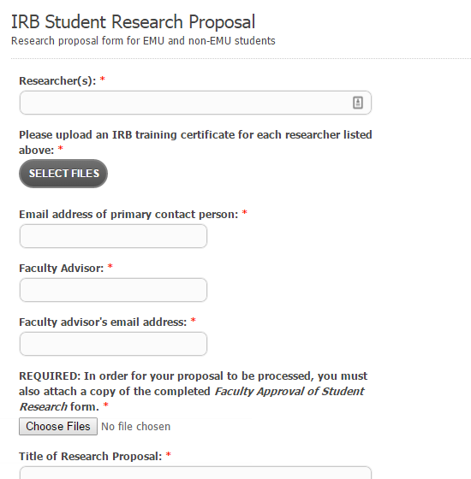
The Proposal
Let’s take a look at the elements of the proposal before we explore how to approach each.
Remember that the submission link for students and for faculty are different; be sure you have identified the correct submission page!
Link: Student Proposal Form emu.edu/irb/proposal/student/

Slide 8
How do I write a great proposal on my first attempt?
Description of research and the purpose:
Include why the research is important. If you are using a vulnerable population it would be important to describe this carefully
This section guards against frivolous or burdensome research; what gap does your research fill in the literature, for example
Method (Participants):
Clearly describes who will participate
How many participants do you hope to include?
How will you recruit these participants?
Will you screen participants and how?

Slide 9
Strong proposals, continued
Identify Vulnerable Groups
Remember that each vulnerable group has particular needs that will need to be considered
Prisoners or Institutionalized persons
Pregnant women/fetuses
Children under 18 (educational settings with typical educational approaches do NOT constitute special populations)
Seriously ill or persons with disabilities
Etc.
Make a careful estimate of the time that will be required of your participants

Slide 10
Informed Consent
Describe how you will inform your participants about the purpose and procedures of the study
Describe how you will assess participant understanding of their rights and of the process and purpose of the research
Participants must be give consent to be photographed, video-taped or audio-taped whether or not you intend to share these in a presentation
Outline how you will secure these recordings
Include contact for the EMU IRB Board
Upload your drafted informed consent
Link: Informed Consent Template emu.edu/irb/consent/
Give careful attention to your informed consent form; it is one area that often delays approval!

Slide 11
Describing Risks
Risks include physical or emotional consequences to the participant as a result of participation, examples might include:
Sadness, anger or other types of emotional distress upon reflection on research topic
Physical discomfort from participation in the study
Potential risk to health
Impact of deception incorporated into research design
Etc.
If you identify a risk, please also specifically identify how you will address any adverse consequences, examples might include:
A list of local counselors will be provided to those who participate and those who show distress will be encouraged to contact a counselor

Slide 12
Describe Benefits
This section serves to assure that benefits don’t unduly influence vulnerable persons to participate (e.g., offering a significant amount of money to the poor in order to entice their participation in high-risk medical experiments)
Describe any benefits to your participant, examples:
Gift cards
Monetary payment
Etc.

Slide 13
Reporting Results
You are asked to describe how and to whom your results will be reported.
List:
Journal, newsletter, other print materials
Professional conferences
Classroom presentation
Remember, your ability to share your results is limited to what is described in your proposal—if you only include classroom presentation, you will have to write an additional proposal if you later want to present at a conference, for example.

Slide 14
Anonymity & Confidentiality
Describe how you will maintain confidentiality and/or anonymity
Will you provide pseudonyms and change identifying information (qualitative), for example?
How will you secure your data?
Data should be password protected or encrypted
Consider maintaining health related research data in HIPPA compliant forms (encrypted, not stored on a Google drive)

Slide 15
Method: Procedure & Apparatus
Method (Procedures): Describes how you will conduct your research, the procedures of your research & collection of data, and how the data will be processed
Method (Apparatus):
Describe all instruments or equipment you plan to use:
Camera
Video recorders
Audio-recorders
Survey instruments
Attach any researcher-created instruments
Qualitative studies that include an interview should include your proposed questions

Slide 16
Common Problems that Can Delay Approval
Remember to attach your NIH certificate
Remember your faculty approval form… and don’t forget to attach one that is signed
Carefully review your consent form. Does it fully and completely inform your client about what is being asked of them and potential risks & benefits?
Have you included EMU IRB contact information?
Have you attached your consent?
Fully describe how you will protect your data & participant confidentiality
Have you attached any surveys or researcher created interviews?

